Slide 1
Women’s candlelight is still burning
Eunju KIM(Director/Center for Korean women & politics)

Slide 2
Candlelight and Democracy
Constitution of the Republic of Korea Article 1
• The Republic of Korea shall be a democratic republic
• The sovereignty of the Republic of Korea shall reside in the people and all state authority
shall emanate from the people
Implementation of original constitutional spirit
- Self-awareness of the nation as a sovereign and real experience of the principle of national sovereignty
- Peaceful demonstrations and street marches in the spirit of the Constitution = the scene of civil education
Collective experience of public happiness through victory and new democracy
- Sublimation of anger against unconstitutional and illegitimate regime into legal resistance
- Street march is proceeded with the permission of the court
- Responding to unjust social structures and practices by satire and humor → refraining from excessive behavior and demand not to
undermine candlelight’s spirit
- Discussions and deliberations throughout the candlelight movement demonstrate the possibility of a new democracy based on
participation and deliberation
Emergence of women nation and women citizen as political sovereigns and speakers of political opinion

Slide 3
Women with candlelight
Gender Status of Candlelight movement Participants
- Female 48%, Male 52% in total
- Teenagers and 20s, more women
- Strong desire for change in
teenagers and twenties
* Big Data Analysis: Every Saturday,
November 2016/ 6 pm ~ 8 pm
Gwanghwamun Square area (550m *
350m) Population analysis

Slide 4
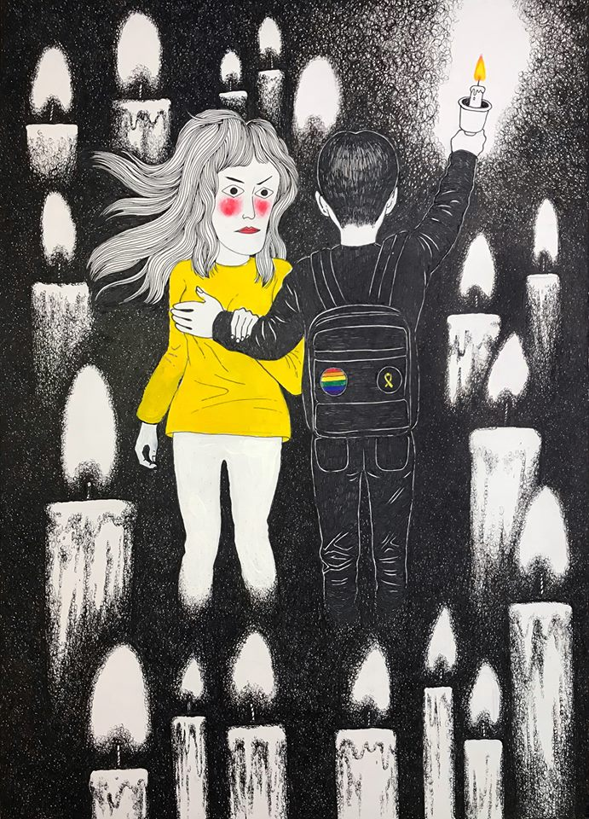
Misogyny in Candlelight movement
Park Geun-hye's Failure = Women's Failure
Two lines in front of a woman
- Fight for President Park's retirement
- Fight against sexual harassment and misogynistic speech &
expressions in on-off line space
Misogynistic expressions
- Do not dream of a woman president in the next 100 years in the
Republic of Korea. - The president threw the power….. to Aneoga(slang of woman)
- Chicken X, Coward X, Miss Park, etc.
Title: Righteous man
Picture: Purplepian Illustration

Slide 5
Efforts for assembly without misogyny and discrimination
Preparing Guidelines for equal rally and Apologies for misogynistic speech from rally of [the People's Strike Struggle Headquarter]
Activities of women's organizations
- Cancel of DJ.DOC performance: expressions demeaning women in the lyrics (Miss Park)
- Operation of Femizon and Femi volunteers, Pot cast, etc.
- Establishment of action rules: Report on disgusted speech or plan cards including misogynistic
expressions
Women's groups have declared that expressions demeaning women and misogynistic speech can not be justified even though the person who are criticized is women like Park Geun-hye and Choi Soon-sil.

Slide 6
Candlelight and gender equality constitution amendment
Completion of the candlelight movement is to constitute a new constitution to realize a new democracy
- Constitution, which is made by the involvement of all citizens who transcend sex, race, etc.
- We should all be co-authors of the new Constitution.
Journey to Gender Equality Constitution
- On February 10, 2017, [Constitutional Amendment Women's Solidarity] announced the 10th
Constitution amendment through the discussion on "Equality and Constitution amendment"
- Suggestion of constitutional amendment by individual women's organizations
- Establishment of[ women’s action for the elimination of gender discrimination]→ Press
conference, party representative visit, petition for legislature, signature campaign, street march,
etc.
- March 26, 2018 proposing constitution amendment in the side of government because of
- May 24, 2018 rejected in national assembly

Slide 7
Women citizen require equal representation(parity) with men as sovereign
 | Contents
Women’s group | States should affirmatively take action in all areas of employment, labor, family, welfare, and finance, and ensure equal participation of women and men in elected positions and office in order to substantially eliminate existing gender discrimination and violence
National assembly advisory committee | Article 14 (3) State shall affirmatively take measures to realize substantial equality and to correct existing discrimination. Article 15 (1) State guarantees gender equality in all areas including employment, labor, welfare and finance. (2) State shall promote the equal participation of men and women in the advancement of elected and appointed positions, and shall ensure an equal access to occupational and social status.
Government | Article 11 (2) State shall try to correct the state of discrimination due to gender or disability and to realize practical equality (except for parity)

Slide 8
Candlelight movement by women is still on going
2017’s warning to #metoo of 2018
“Whether the president changes or does not change, the life of a woman does not change a little. The male-dominated patriarchal order is not hurt a bit ... ... Those who cry for justice and progress in misogynistic slogans are not in tune with the struggle for the survival of women ... It should be remembered that the current rally is not just a fight for women, it is a huge man's play to defend a nation built in male-centered order in a male-centered way (Ha Seung Woo et al. (2017) From the people>, p. 63) "

